Slide 1
Building a Retirement Income Plan
The Northwestern Mutual Life Insurance Company — Milwaukee, WI
William J. Cooper CLU, ChFC
Wealth Management Advisor
California State License #0G49537:
Northwestern Mutual is the marketing name for The Northwestern Mutual Life Insurance Company (NM), Milwaukee, WI (life and disability insurance, annuities, and life insurance with long-term care benefits) and its subsidiaries.
29-5184-17 (Rev 1218)

Slide 2
Am I Going to Outlive My Money?
The rules have changed
Past:
Retirement primarily funded by employer
Present: Responsibility has shifted to individuals
2

Slide 3
Retirement Income Planning
Phases of Retirement Planning
6 key Retirement Risks
Strategies for Creating a Sound Retirement Income Plan
Let’s get started!
3

Slide 4
Do you think you’ll outlive your savings?
4

Slide 5
Shifting the Focus
67%
More than two-thirds of Americans believe there is some chance they will outlive their savings
Northwestern Mutual Planning and Progress Study, 2018
5

Slide 6
To Retirement vs. Through Retirement
Accumulating Funds
$
Distribution of Funds
Once you’ve retired, you switch from accumulating funds to distributing them. How you do that can make a big difference in how long your money lasts.
6

Slide 7
Is the 4% Rule Still Valid?
Today, withdrawing a set amount is riskier.
Market volatility
Living longer
Withdrawal strategies
7

Slide 8
Phases of Retirement Planning
8

Slide 9
Investing Time Frame
In accumulation, your investing time frame is basically known.
During distribution, time becomes a wildcard.
Retirement
Time Horizon Known
Time Horizon Unknown
9

Slide 10
Risk and Return
Goal: Get highest return on your money.
Goal: Generate the most income possible.
Retirement
Driving Force: Growth
Driving Force: Income
Time Horizon Known
Time Horizon Unknown
10

Slide 11
Sequence of Returns
Timing of losses can have a major impact on a retirement portfolio’s likelihood of success.
Retirement
Driving Force: Growth
Driving Force: Income
Time Horizon Known
Time Horizon Unknown
11

Slide 12
$500,000
Sequence of Returns
How it can affect your retirement
$500,000
Retirement Plan Savings
50% STOCKS | 50% BONDS
5%
a year withdrawal
starting January 1, 1973
Hypothetical example for educational purposes only. Not intended to represent a specific security or investment.
12

Slide 13
Sequence of Returns
How it can affect your retirement
Actual Historical Return Sequence
Reversed Actual Historical Return Sequence
$2.5 mil
$2.5 mil
2.0
2.0
1.5
1.5
1
1
.5
.5
0
0
1973
1977
1981
1985
1989
1993 1994 1993 1989
1985
1981
1977
1973
Stocks in this example are represented by the Standard & Poors 90 index from 1926 through February 1957 and the S&P 500® index thereafter, which is an unmanaged group of securities and considered to be representative of the U.S. stock market in general. Bonds are represented by the five-year U.S. government bond and inflation by the Consumer Price Index. Each monthly withdrawal is adjusted for inflation. An investment cannot be made directly in an index. Past performance is no guarantee of future results. Hypothetical value of $500,000 invested at the beginning of 1973 and August 1994. Assumes inflation-adjusted withdrawal rate of 5%. Portfolio: 50% large-company stocks/50% intermediate-term bonds. This is for illustrative purposes only and not indicative of any investment. An investment cannot be made directly in an index. © 2014 Morningstar. All Rights Reserved.
13

Slide 14
6 Key Retirement Risks
14

Slide 15
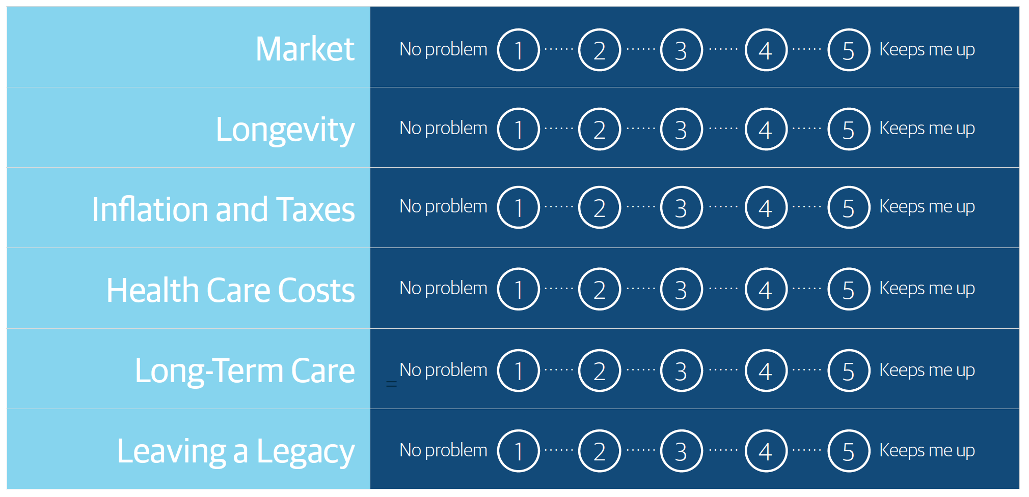
What Keeps You Up at Night?
15

Slide 16
1. Market
Volatility in the investment markets can significantly affect your retirement income and savings.
Market Investments
Retirement Savings
How would you protect your retirement savings against market volatility?
16

Slide 17
1. Market
There are ways to lessen the impact of market volatility on your retirement savings.
Make sure your asset allocation and risk profile are appropriate for you.
Fund essential expenses with guaranteed income sources.
Set up a cash reserve.
17

Slide 18
2. Longevity
The risk that you’ll outlive your money.
88+ 90+
YEARS OF AGE YEARS OF AGE
94+
YEARS OF AGE
Single: 50% chance a 65-year-old man will live beyond the age of 88.
Single: 50% chance a 65-year-old woman will live beyond the age of 90.
Married: 50% chance one of them will live beyond the age of 94.
Plan for a retirement that could last 30 years or longer.
Based on the 2012 Individual Annuity Mortality Period Table with Projection Scale G2.
18

Slide 19
2. Longevity
What is guaranteed income?
=
Pensions
Social Security
Income Annuities
Guaranteed Income
Income Annuities
Income annuities are contracts with an insurance company where you convert a part of your retirement savings into guaranteed income for your lifetime or a specific period of time.
401(k)
IRA
Roth
Guaranteed Income
All guarantees in annuities are backed solely by the claims-paying ability of the issuer.
19

Slide 20
3. Inflation and Taxes
Inflation can reduce your purchasing power.
Impact of Inflation on Your Retirement Income
Years | 3% | 4% | 5%
0 | $100,000 | $100,000 | $100,000
5 | $86,000 | $82,000 | $78,000
15 | $64,000 | $56,000 | $48,000
25 | $48,000 | $38,000 | $30,000
30 | $41,000 | $31,000 | $23,000
Consider including stocks in your portfolio for the potential to keep pace with inflation, and consider delaying Social Security until age 70, if possible.
20

Slide 21
3. Inflation and Taxes
What about taxes?
For many people, taxes are one of the largest annual expenses in retirement.
Taxes
21

Slide 22
3. Inflation and Taxes
So what’s the solution?
Tax planning.
Choose the right accounts to draw from.
Convert a portion of your tax-deferred accounts to a tax-free account, such as a Roth IRA.
Use permanent life insurance cash value.*
$
Drawing from taxable and tax-deferred accounts in the right order can make your money last longer.
*Utilizing the cash values through policy loans, surrenders, or cash withdrawals will reduce the death benefit; and may necessitate greater outlay than anticipated and/or result in an unexpected taxable event. Assumes a non-Modified Endowment Contract (MEC).
22

Slide 23
4. Health Care Costs
Medical costs continue to rise.
Fewer employers are providing retiree benefits.
Medicare isn’t free and has limitations.
Factor health care costs into your budget—just like other essential expenses.
23

Slide 24
4. Health Care Costs
What’s the solution?
Understand what Medicare does and does not cover.
Include health care costs in your budget.
Estimated Annual Out-of-Pocket Health Care Expenses in Retirement
65-year-old individuals on a per-individual / per-year basis
Health | Cost Estimate
Excellent | $4,450
Good | $7,620
Poor | $14,150
Amounts are based on estimated annual health care costs for 65-year-old individuals using statistical information obtained from www.medicare.gov, 2017. They include the cost of premiums, deductibles and co-pays. They do not include long-term care costs. Based on data from the Centers for Medicare and Medicaid Services, assume an annual inflation rate of 6% for health care expenses.
24

Slide 25
4. Health Care Costs
Health Care Example
Medicare Part B
$100/month
Supplement
$100/month
Part D
$50/month
Out-of-Pocket
$50 - $100/month
Total = $300 - $350/month or
$3,600 - $4,200 annually
25

Slide 26
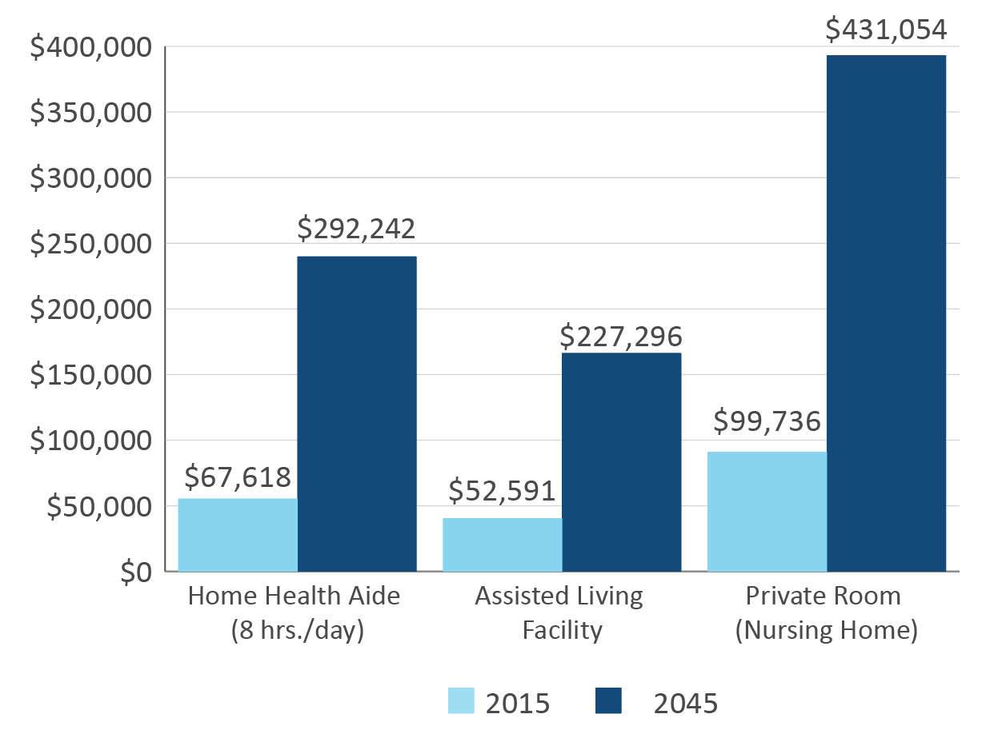
5. Long-Term Care Needs
Expenses associated with a prolonged illness that requires special care can
deplete retirement savings.
Include funding for long-term care in your retirement plan to help protect your savings and reduce reliance on others.
Northwestern Long Term Care Cost of Care Survey, conducted nationwide, November 2015. Long Term Care Group, Inc. Future Cost based on 5% annual increase. These future costs are not guaranteed.
26

Slide 27
6. Leaving a Legacy
Without adequate planning, you may not be able to leave a financial legacy and meet your retirement income needs.
Start your legacy planning as early as possible.
27

Slide 28
How much time did you spend planning your last vacation?
28

Slide 29
Retirement Will Be the Longest Vacation of Your Life
Put the time in.
Plan for it.
Make sure your money lasts.
It’s a lifelong process that takes thought, planning,
and ongoing reviews and updates as your life changes.
29

Slide 30
Strategies for a Sound Retirement Income Plan
30

Slide 31
1. Create Income for Life
Create a budget:
Determine your essential and discretionary expenses.
Match essential expenses with fixed income sources.
Essential Expenses:
Fixed Income Sources:
Social Security
Pension
Annuities
Housing
Utilities
Food
Health Care
Taxes
Etc.
Take care of essential expenses first.
31

Slide 32
1. Create Income for Life
Figure out how to fund what you need.
Understand your sources of retirement income.
Social Security
Pension
Annuity
Employer- Sponsored Plan
Individual Retirement Account
Personal Savings & Investments
Business Assets
32

Slide 33
Assessing Your Retirement Income
Pre-Retirement Income
Deferred
Investments
401(k), IRA
Roth
Life
Annuities
Insurance
Income Annuities
Social Security
Pension
Cash Reserve
Retirement Income
33

Slide 34
2. Protect Your Assets
Protect yourself against events that can interfere with your ability to earn income or deplete your savings.
Include both offensive and defensive strategies in your retirement plan.
$
Retirement Plan
Offensive
Defensive
34

Slide 35
3. Leave a Legacy
Leave a financial legacy while having the freedom to spend what you’ve saved for retirement.
A comprehensive plan can help ensure your estate benefits the people and charities that matter most to you.
35

Slide 36
The Northwestern Mutual Retirement Strategy
Change the conversation around retirement income.
Proprietary, patent-pending retirement planning tool. Thousands of hypothetical plans tested.
Multiple options designed to optimize income throughout your life.
Solutions designed to help you achieve your retirement goals.
We developed solutions designed to help you achieve your retirement goals with a high probability of success.
36

Slide 37
Managing Uncertainty
Our Goals:
Identify the maximum amount of lifetime income.
Plans that provide a high level of financial security.
Take guesswork out of creating retirement income.
* Northwestern Mutual tested Retirement Allocation Strategies with the Retirement Analytical Monte Carlo tool running 500 trials. A plan with a 90% confidence level means that in 90% of the trials (450), the plan provided a specified amount of income over the lifetime of a hypothetical retiree. A 75% confidence level option is available. While Monte Carlo simulations can test the probability of outcomes, they are hypothetical, do not reflect actual investments results and are not guarantee of future results.
37

Slide 38
Retire With Confidence
Let Northwestern Mutual help you build a financially secure retirement.
38

Slide 39
Thank You
Northwestern Mutual is the marketing name for The Northwestern Mutual Life Insurance Company (NM), Milwaukee, WI (life and disability insurance, annuities, and life insurance with long-term care benefits) and its subsidiaries.

